Slide 1
Autoencoders
CSCI 4360/6360 Data Science II

Slide 2
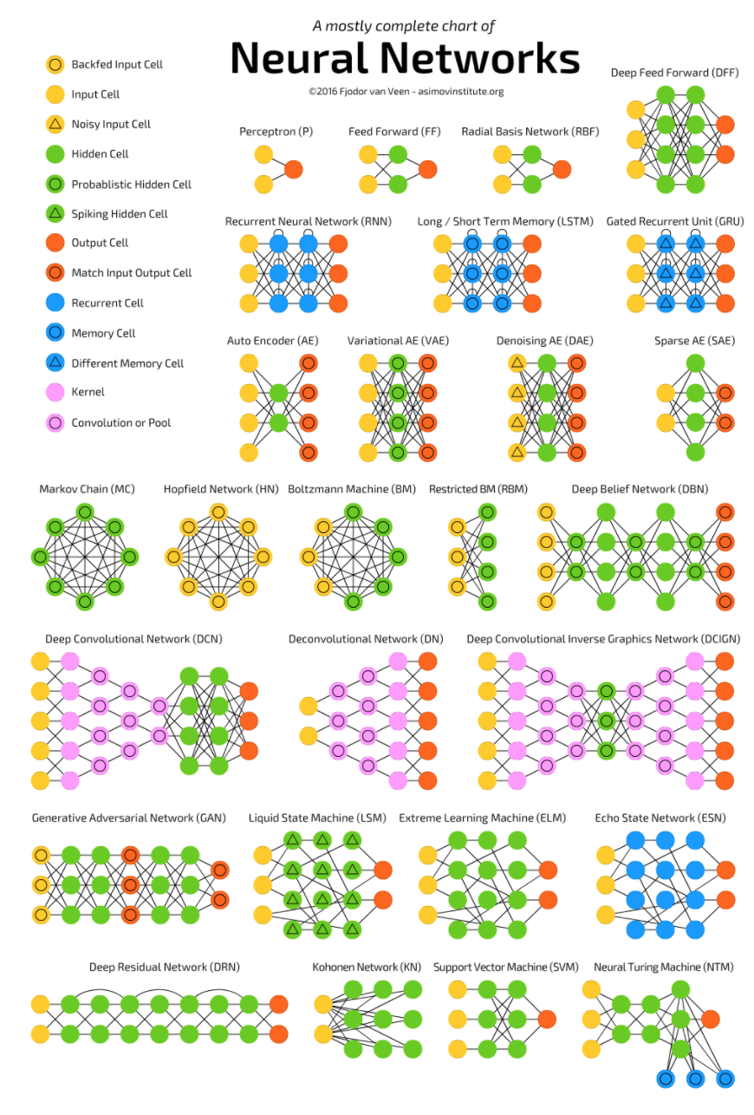
The Neural Network Zoo
http://www.asimovinstitute.org/neural-network-zoo/

Slide 3
The Neural Network Zoo
http://www.asimovinstitute.org/neural-network-zoo/
Today

Slide 4
Dimensionality Reduction
Reduce the number of random variables under consideration
Reduce computational cost of downstream analysis
Remove sources of noise in the data
Define an embedding of the data
Elucidate the manifold of the data
We’ve covered several strategies so far

Slide 5
Principal Component Analysis (PCA)
Orthogonal projection of data
Lower-dimensional linear space known as the principal subspace
Variance of the projected data is maximized
Two definitions of PCA
Maximizing Variance
Minimizing Reconstruction Error

Slide 6

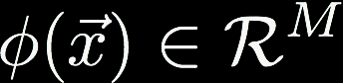
Kernel PCA
In kernel PCA, we consider data that have already undergone a nonlinear transformation:
We now perform PCA on this new M-dimensional feature space

Slide 7
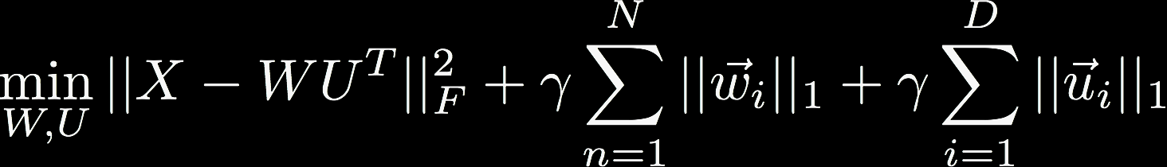
Sparse PCA
We still want to maximize u_{i}^{T}Su_{i}, subject to u_{i}^{T}u_{i} = 1
…and one more constraint: we want to minimize ||u_{i}||₁
Formalize these constraints using Lagrangian multipliers

Slide 8
Stochastic SVD (SSVD)
Uses random projections to find close approximation to SVD
Combination of probabilistic strategies to maximize convergence likelihood
Easily scalable to massive linear systems

Slide 9
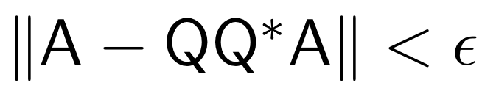
A brief aside: SSVD
Matrix A
Find a low-rank approximation of A
Basic dimensionality reduction
Preconditioning
Notes:
Construct a low dimensional subspace that approximates the range of A.

Slide 10
Approximating range of A
INPUT: A, k, p
OUTPUT: Q
Draw Gaussian n x k test matrix Ω
Form product Y = AΩ
Orthogonalize columns of Y ➔Q
Notes:
-Matrix A is m by n
-k is the desired number of dimensions of the low-rank representation (e.g. 10, 100, something significantly smaller than n)
-p is the oversampling parameter

Slide 11
Approximating SVD of A
INPUT: Q
OUTPUT: Singular vectors U
Form k x n matrix B = Q^{T}A
Compute SVD of B = ÛΣV^{T}
Compute singular vectors U = QÛ

Slide 12
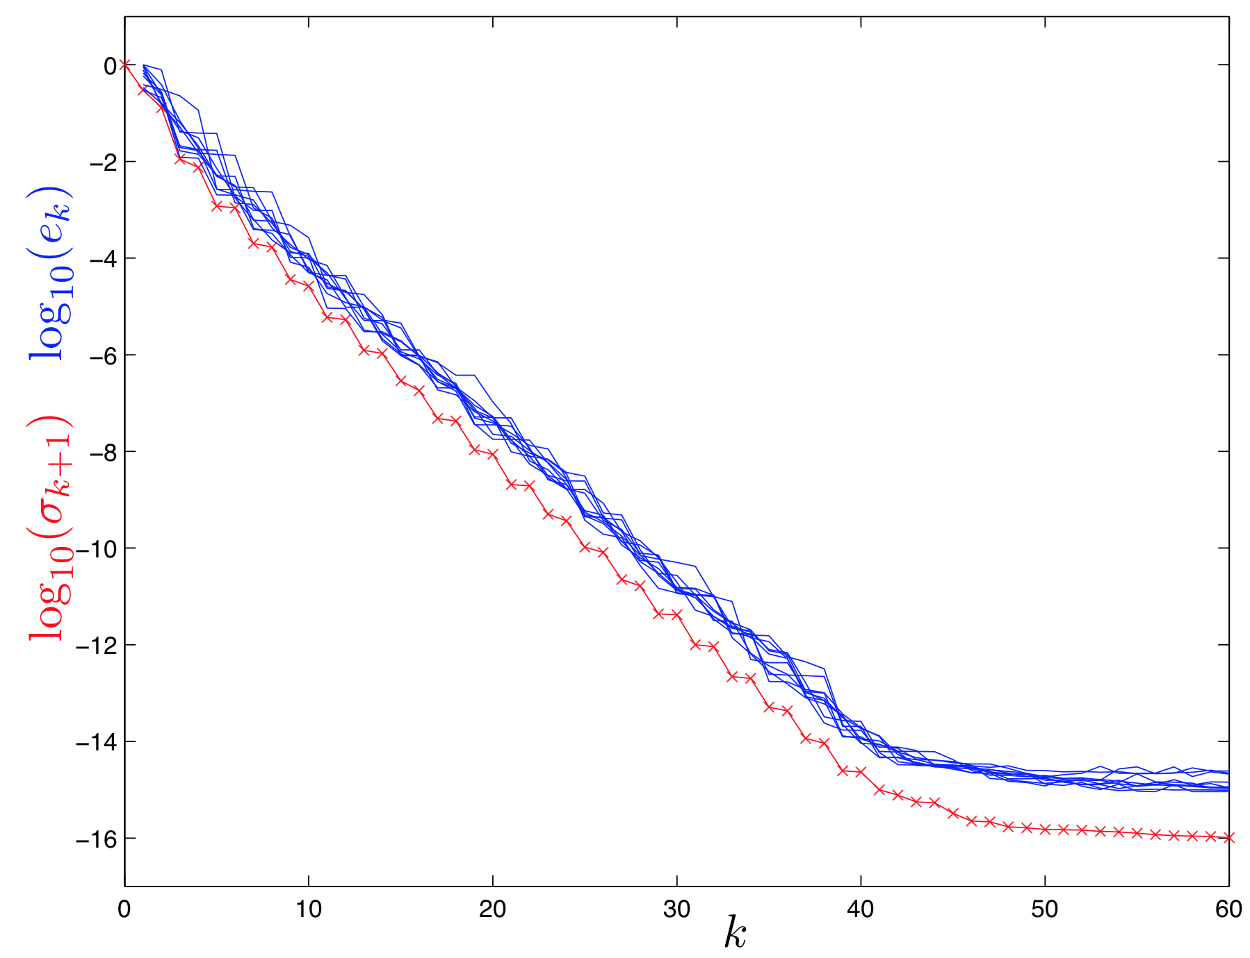
Empirical Results
1000x1000 matrix
Several runs of empirical results (blue) to theoretical lower bound (red)
Error seems to be systemic
Notes:
Blue lines: 10 iterations of SSVD
Red line: full SVD of original A

Slide 13
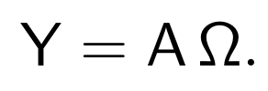
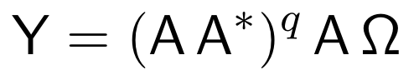
Power iterations
Affects decay of eigenvalues / singular values
Notes:
(sketch small proof of eigenvalue decay rate)

Slide 14
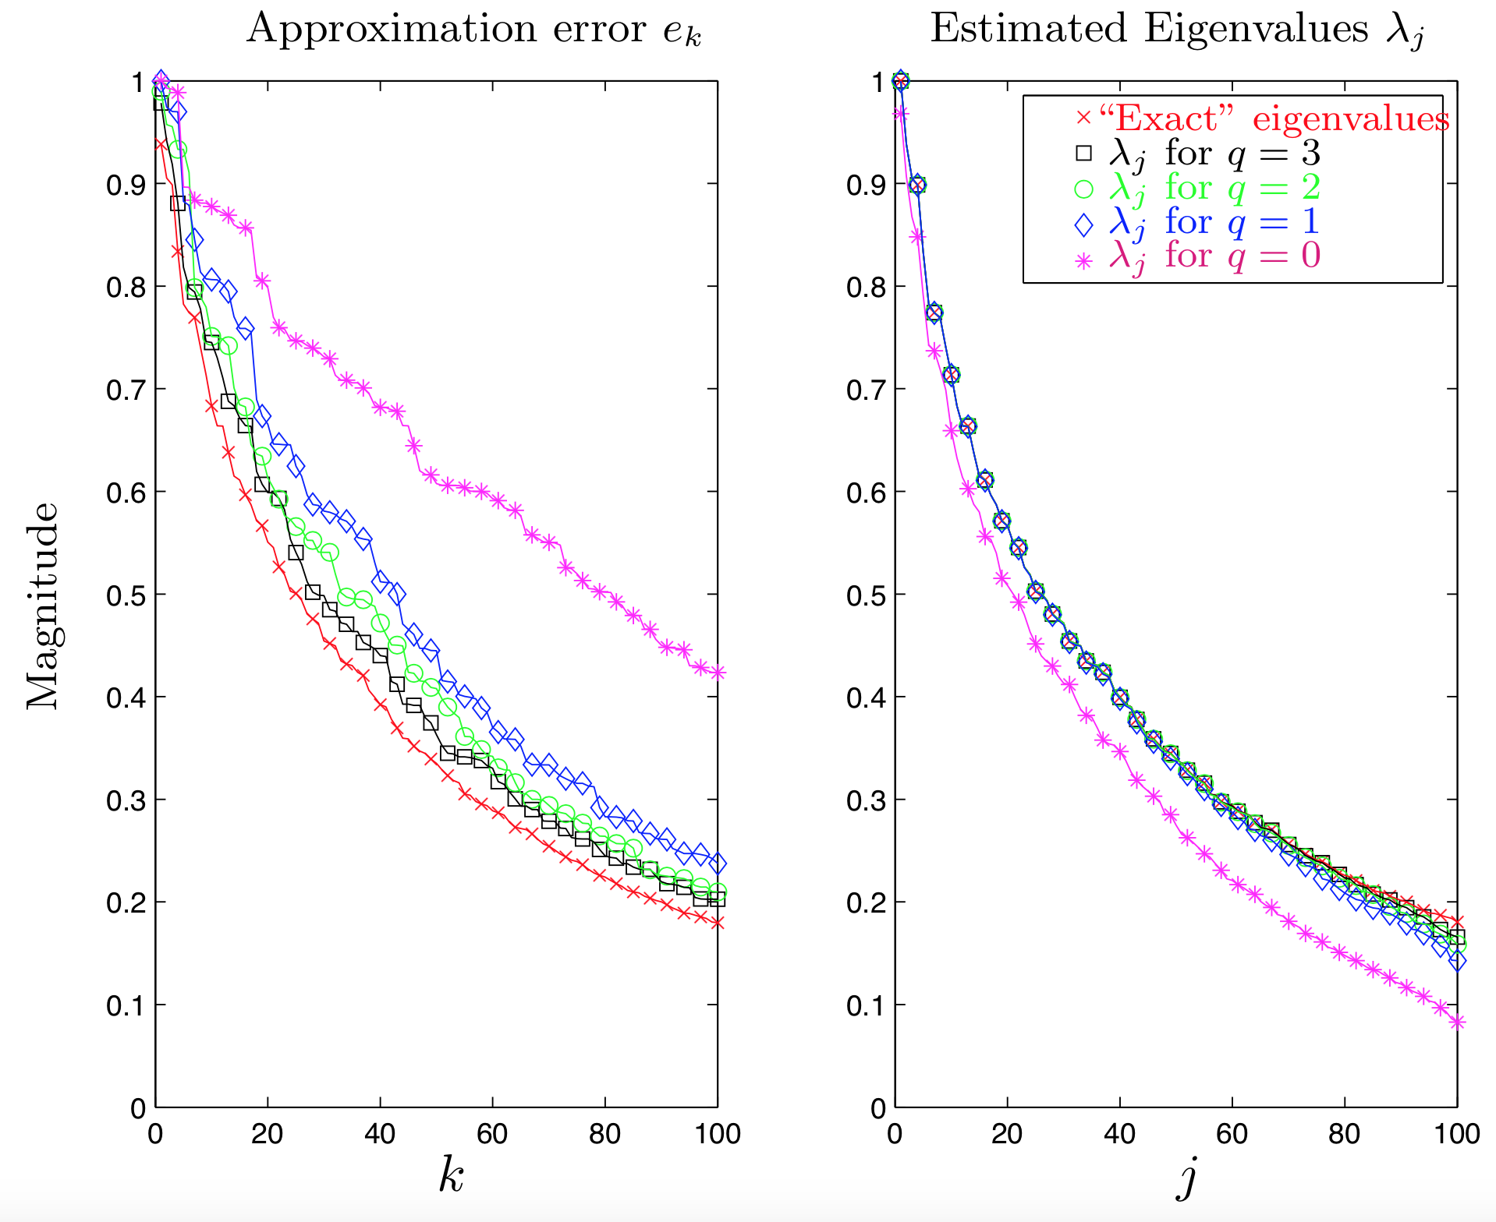
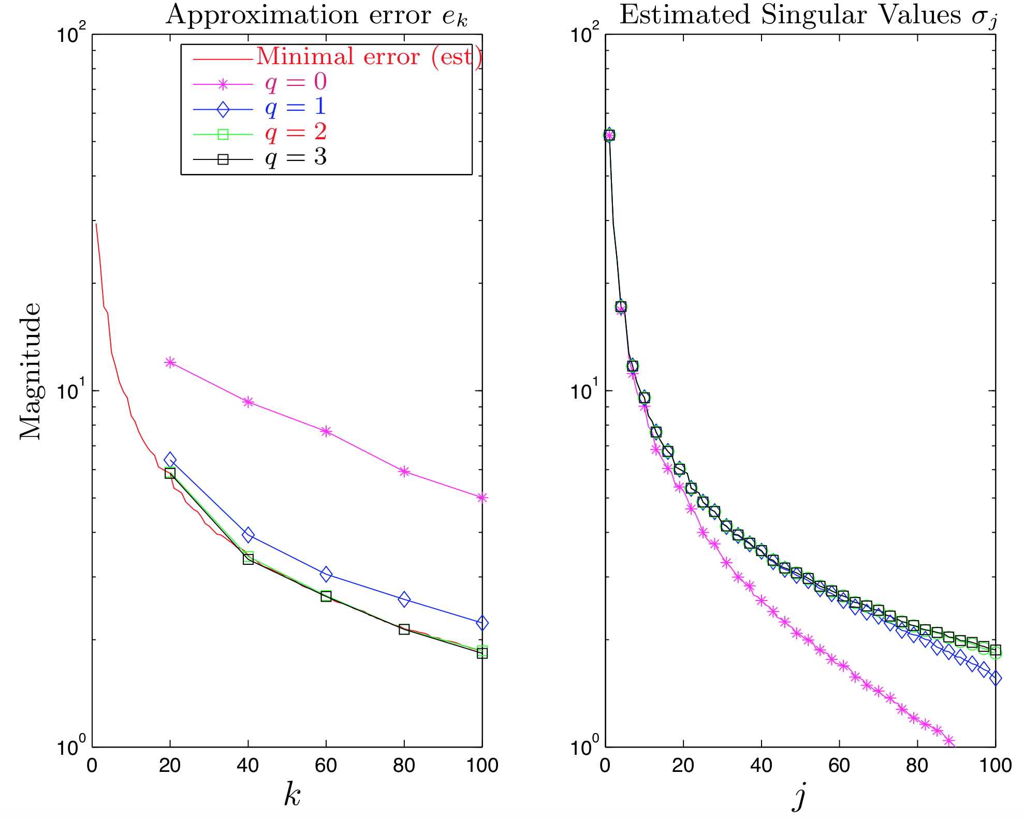
Empirical Results

Slide 15
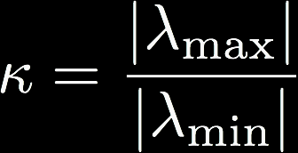
Why does this work?
Three primary reasons:
Johnson-Lindenstrauss Lemma
Low-dimensional embeddings preserve pairwise distances
Concentration of measure
Geometric interpretation of classical idea: regular functions of independent random variables rarely deviate far from their means
Preconditioning
Condition number: how much change in output is produced from change in input (relation to #1)
Q matrix lowers condition number while preserving overall system

Slide 16
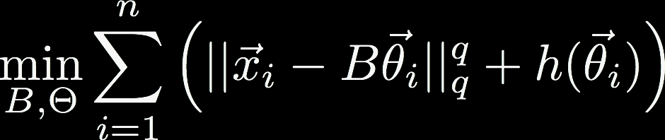
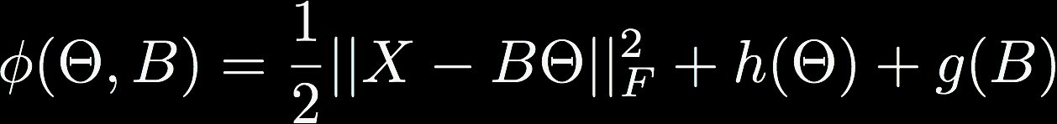
(and we’re back) Dictionary Learning
This gives the minimization where h promotes sparsity in the coefficients, and B is chosen from a constraint set
The general dictionary learning problem then follows where specific choices of h and g are what differentiate the different kinds of dictionary learning (e.g. hierarchical, K-SVD, etc)

Slide 17
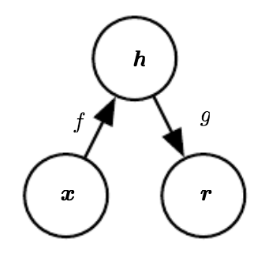


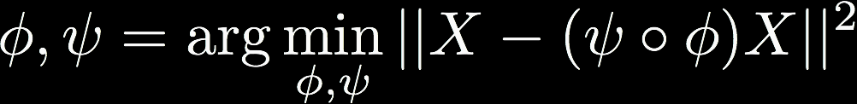
Autoencoders
”Self encode”
ANNs with output = input

Slide 18
Autoencoders
Learn a “non-trivial” identity function
Low-dimensional “code”
No other assumptions
PCA: maximize variance / minimize reconstruction
Linearly independent
Gaussian
Dictionary Learning: sparse code / minimize reconstruction
Nonlinear
Kernel / Sparse PCA
+
-
Very compact representation
No strong a priori form (flexible)
Difficult to interpret
Prone to ”collapse”
Notes:
Nonlinear encoding / decoding functions result in a powerful generalization of PCA
- too much capacity, however, results in an autoencoder just copying the data without “learning” anything

Slide 19

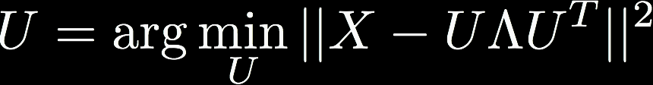
Autoencoders
Key point: autoencoders should be undercomplete
Code dimension < input dimension
L is some loss function penalizing g(f(x)) for being dissimilar from x
If f and g are linear, and L is mean squared error, undercomplete AE learns to span the same subspace as PCA

Slide 20

Sparse Autoencoders
g(h) is decoder output
h = f(x), encoder output
Ω is sparsity penalty
Note on regularizer
No straightforward Bayesian interpretation of regularizer
“Typical” penalties can be viewed as a MAP approximation to Bayesian inference, with regularizers as priors over parameters
Regularized MAP then maximizes:
But autoencoder regularization relies only on the data. It’s more of a “preference over functions” than a prior.
Notes:
- Log-prior term incorporates preference over parameters (which is how regularization usually operates)

Slide 21

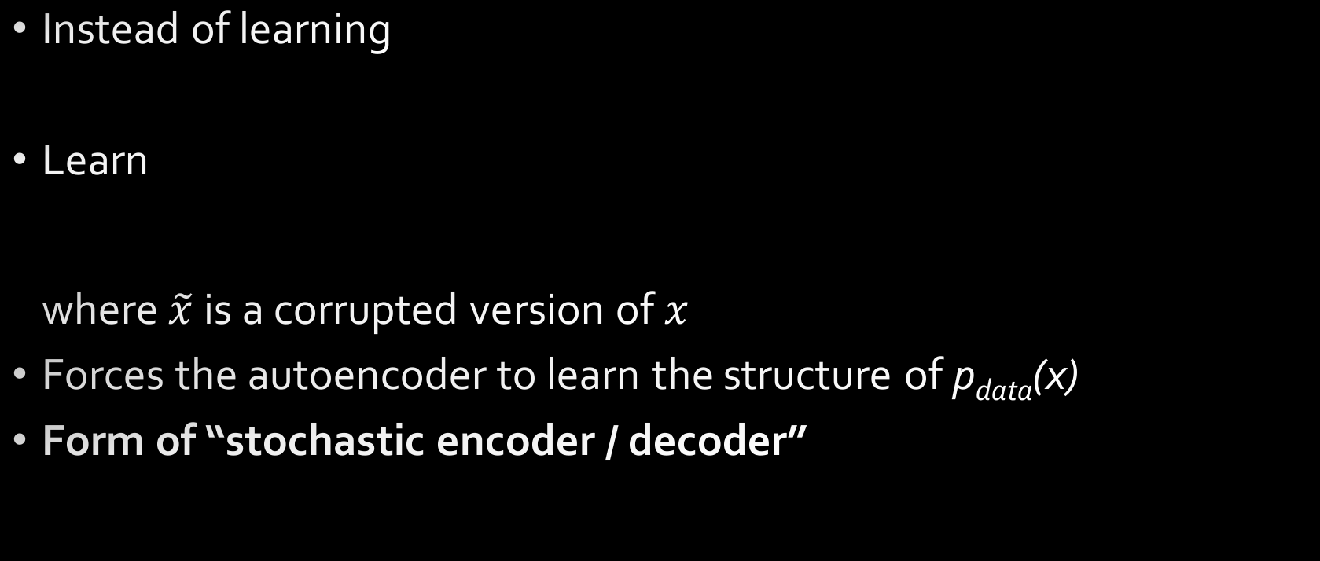
Denoising Autoencoders
Instead of learning
Learn where $\tilde{x}$ is a corrupted version of $x$
Forces the autoencoder to learn the structure of p_{data}(x)
Form of “stochastic encoder / decoder”

Slide 22
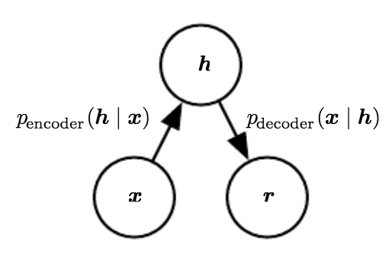
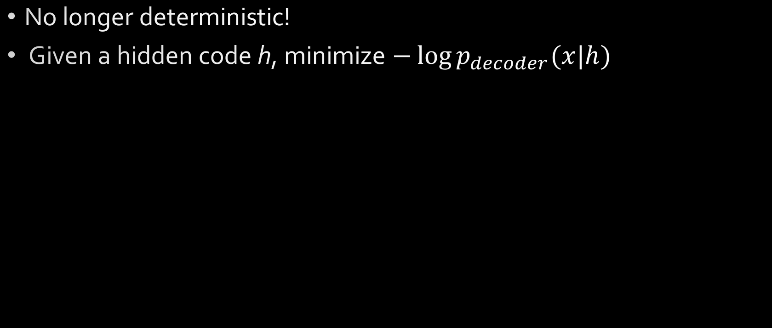
Denoising Autoencoders
No longer deterministic!
Given a hidden code h, minimize $−\log{p_{decoder}(x|h)}$

Slide 23
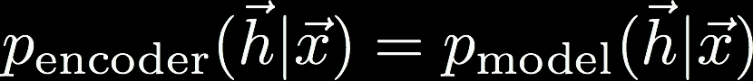
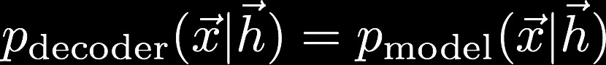
Denoising Autoencoders
Generalize encoding function to encoding distribution
Same with the decoding distribution
Together, these comprise a stochastic encoder and decoder
Notes:
In general, the encoder and decoder distributions are not necessarily conditional
distributions compatible with a unique joint distribution p_model (x, h)
- with enough capacity and training examples, encoder / decoder may become compatible asymptotically

Slide 24
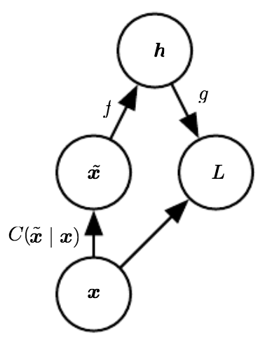

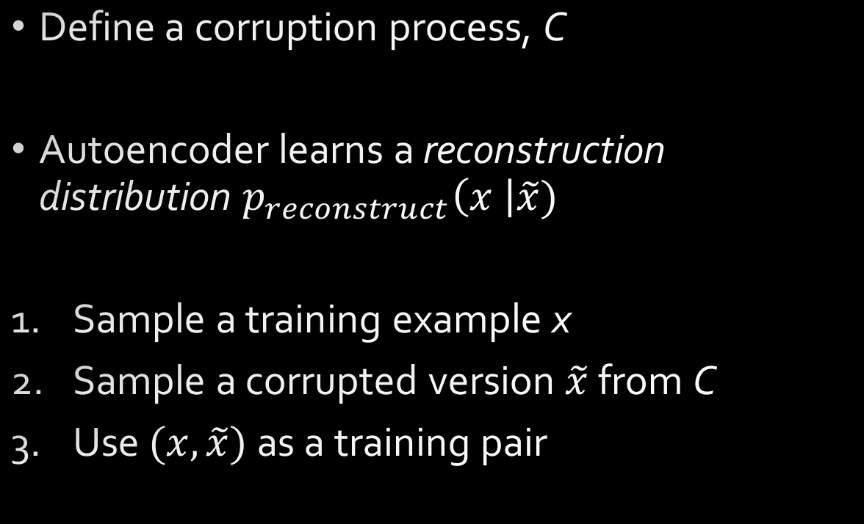
Denoising Autoencoders
Define a corruption process, C
Autoencoder learns a reconstruction distribution $p_{reconstruct}\left(x \right|\tilde{x})$
Sample a training example x
Sample a corrupted version $\tilde{x}$ from C
Use $(x,\tilde{x})$ as a training pair

Slide 25
Denoising Autoencoders
Optimize
Easy choice of C
Sample from training set and compute expectation
Expectation over corrupted examples
…with respect to learning the uncorrupted data from the encoded corrupted data

Slide 26
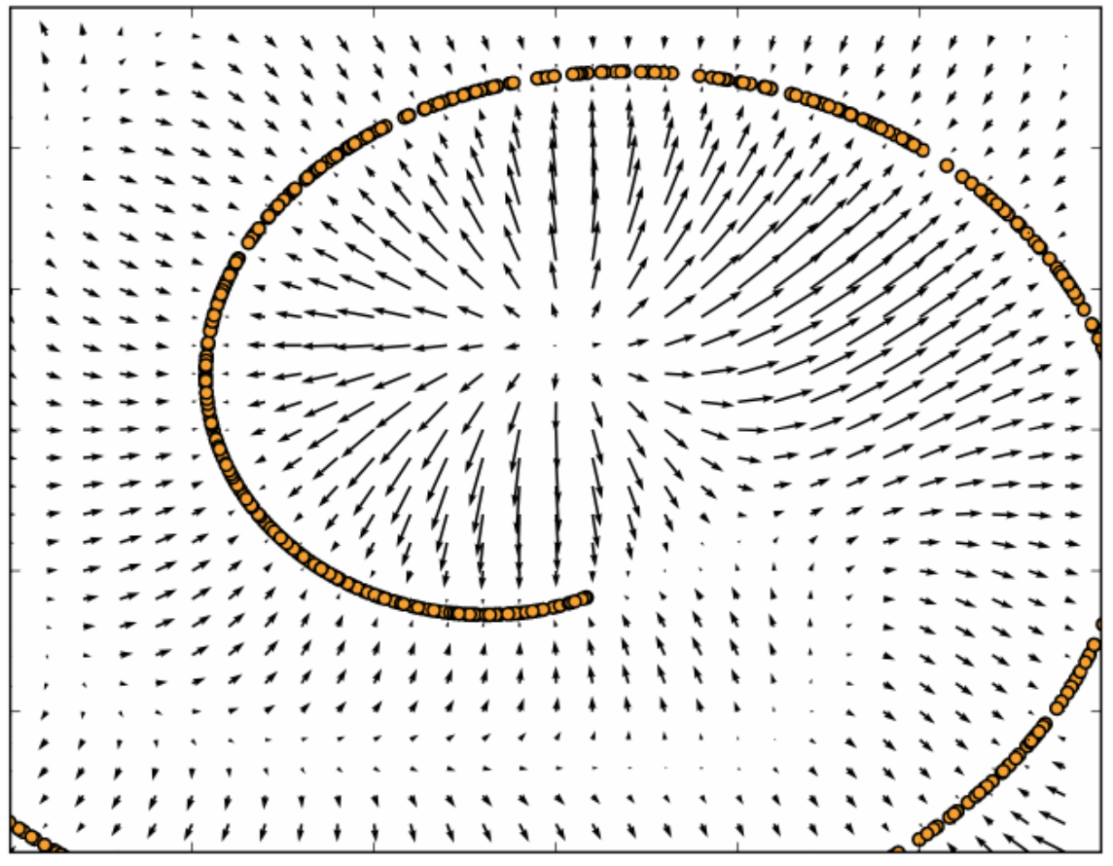
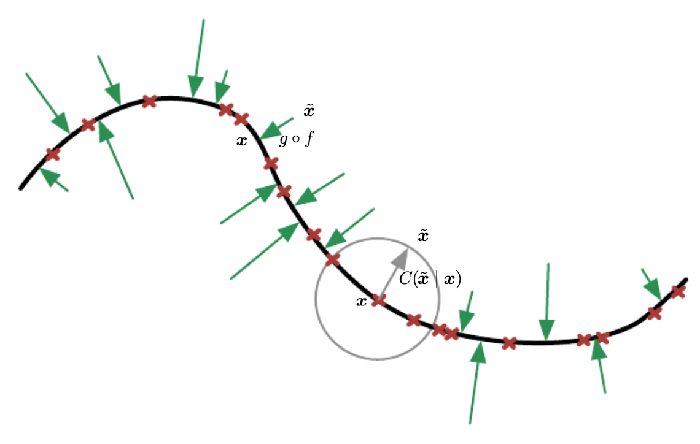
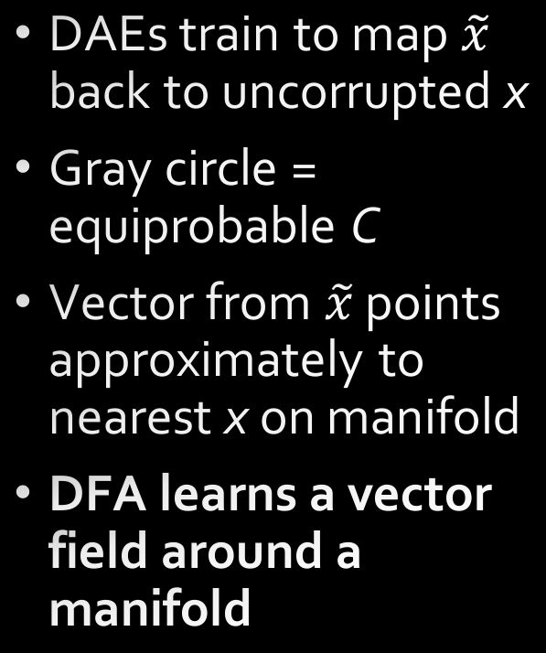
Denoising Autoencoders
DAEs train to map $\tilde{x}$ back to uncorrupted x
Gray circle = equiprobable C
Vector from $\tilde{x}$ points approximately to nearest x on manifold
DFA learns a vector field around a manifold
Notes:
Training examples as red crosses along a low-dimensional manifold (black line)
Corruption process pushes x off manifold
g(f(x_tilde)) estimates the center of mass of the clean points x that could have given rise to x_tilde
DFA learns a vector field of the green arrows
Vector field learned by DFA around 1D curved manifold which the data concentrate in a 2D space

Slide 27
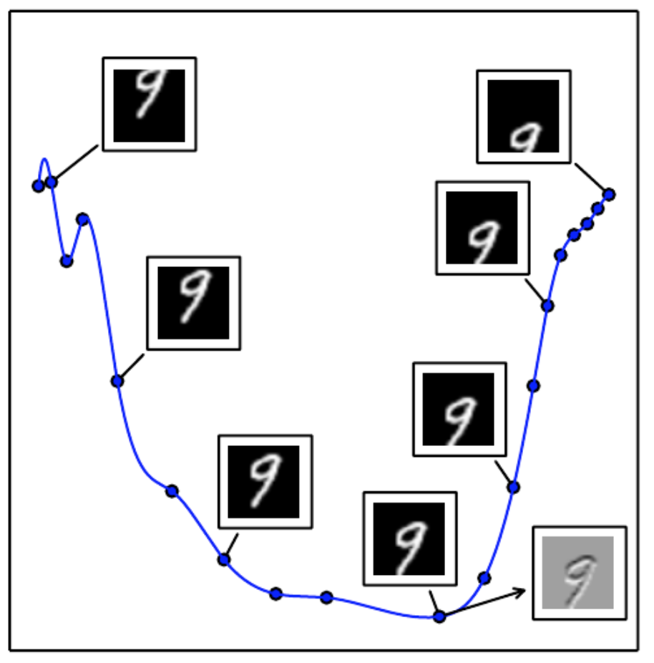
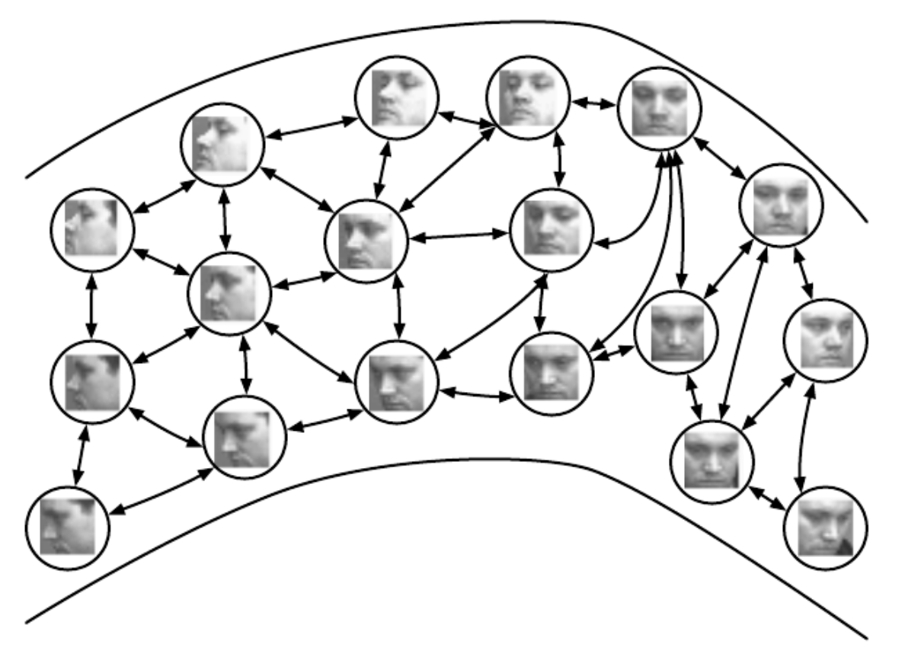
Embeddings
Manifolds would seem to imply representation learning beyond a simple low-dimensional code
Autoencoders can learn powerful relationships in this regard
Pose
Position
Affine transformations

Slide 28
Generative Models
Go beyond learning x -> h, instead focused on learning p(x, h)
Manifold learning with Autoencoders
Variational Autoencoders (VAEs)
Deep Belief Networks (DBNs)
Deep Restricted Boltzmann Machines (DBMs)
Generative Adversarial Networks (GANs)
Thursday!

Slide 29
Conclusions
Autoencoders
Multilayer perceptron (ANN) that is symmetric
Output = input
Goal is to learn a non-trivial identity function, or an undercomplete code h
Sparse Autoencoders
Include a sparsity constraint on the code
Denoising Autoencoders
Learn a mapping to de-corrupt data
Include a corruption process C
Equates to a traversal of the data manifold -> generative modeling primer

Slide 30
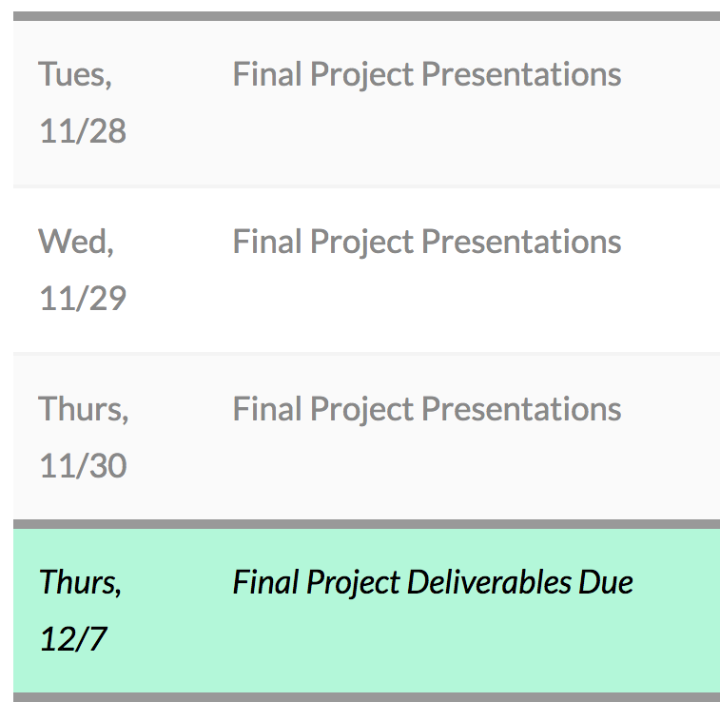
Course Details
Projects!
3 presentations per day
9 teams—20 minutes hard speaking time limit
Presentations are the week after Thanksgiving break
Thursday is FULL
Wednesday is ALMOST FULL
First come, first serve!

Slide 31
References
Deep Learning Book, Chapter 14: “Autoencoders” http://www.deeplearningbook.org/contents/autoencoders.html
DL4J documentation, “Denoising Autoencoders” http://deeplearning.net/tutorial/dA.html

